Slide 1
Digitalisation of Business Processes
Blazenko Babic, Patrik Rüegg, Volkan Yesilyurt

Slide 2
Agenda
Business process introduction
Identified bottlenecks and potentials for improvement
Digitalized to-be process
Demo Showcase
Process Mining / Business Intelligence
Feedback / QA

Slide 3

Business process introduction
Tenant cockpit
Report tenant damage
Online form for damage report with efficient allocation
Notes:
Our business process involves a tenant cockpit where tenants can report damage. We thought that nowadays the process takes far too long for many landlords and that the decision-making processes are not always consistent. This is annoying for the tenant, who has to wait a long time for feedback. It is also not so advantageous for the landlord, because the inefficiency results in higher costs. So we wanted to implement the idea that the tenant can report his damage online using a form. This is intended to achieve greater efficiency, a uniform basis for decision-making and thus improved customer respectively tenant satisfaction.

Slide 4

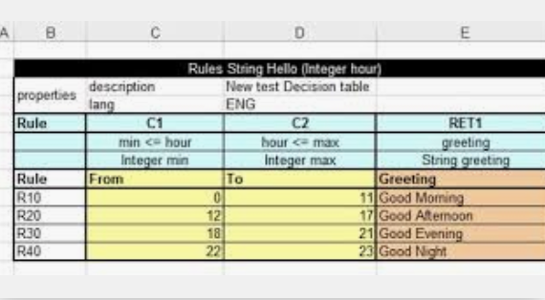
Identified bottlenecks and potentials for improvement
Pain points
Unstructured paperwork
Non-uniform decision
Information gaps
Improvements
Digital forms/conversational AI
Decision tables
Integration services
Notes:
At the beginning of the process, the input of tenant with the damage report could be automated with the help of integration services in order to manage the input (damage report) from the tenant in more efficient and faster way. In the next step, the tenant damage report could be recorded in a digital form. Once the tenant damage report is recorded in a digital form, this would be categorized by using a decision table. With that, the idea is in the next process step to send automatic request from the property manager to maintenance service partner for small issues and a manual request of a bigger issue. Once an order is received from a maintenance service partner, another option would be to optimize the process by having the service partner fill out form by themselves, which speeds up the processing of the offer received. After the offer has been processed, a decision table would be used, which classifies the amount of the initial offer.
In summary, the mentioned digital potentials would make it possible to digitally manage data within a database and to make it accessible and editable at any time and in any location. Furthermore with this, there would be no risk of losing data and the communication channel would be much more efficient and faster.
Information gaps due to missing Single Point of Truth

Slide 5
Digitalized to-be process

Slide 6
Digitalized to-be process

Slide 7
Digitalized to-be process

Slide 8
Process Mining Scenarios
Setup of raw event logs (JSON)
Only internal and completed processes
Analytics Scenarios
Duration of single tasks
Workload distribution
3 main process patterns
Distribution of the cases

Slide 9
Business Intelligence approach
Considered timestamps
Reporting Datetime
Order placed Datetime
Invoice received Datetime
Advantages
Design data and record information
Case specific analysis
Deep and relevant insights

Slide 10
Demo Showcase

Slide 11
Advantages of process digitization​
Automate low value user tasks
Increased transparency
Business Intelligence​
80-90% of cases highly automatable
Notes:
Automate low value user tasks (send tasks / document tenant damage report task)​
Transparency (how many damage reports processed / distribution of workload / automatic documentation of damage reports)​
Business Intelligence (run time of typical process instances spanning over multiple tasks / track order value from proposal to billed amount)​
​
Estimated 80-90% of cases can be highly automated, this allows for more time and better service provided for high damage value cases to correspond with the property owner and the tenant!​
​

Slide 12

Feedback / Q&A

